Slide 1





Distributionally Robust Infinite-Horizon Control: From a Pool of Samples to the Design of Dependable Controllers
Jean-Sébastien Brouillon¹, Andrea Martin¹, John Lygeros², Florian Dörfler², and Giancarlo Ferrari Trecate¹
¹École Polytechnique Fédérale de Lausanne
²Swiss Federal Institute of Technology Zurich
9.12.2025

Slide 2

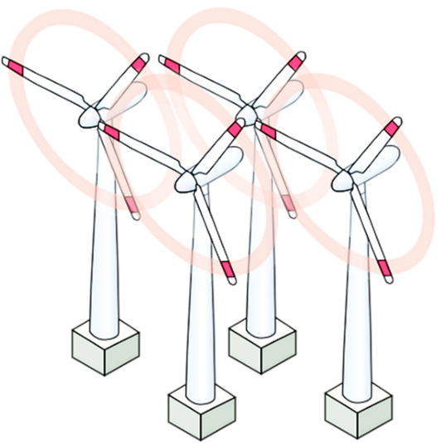

Motivation
Decision-making in modern cyber-physical systems
wind turbulences
neglected dynamics
…how to optimally control a system in the
presence of unmodeled disturbances?
Control policy

Slide 3


Introduction
Decision-making under uncertainty
Current decision influences future rewards…
…yet the future is unknown and unpredictable
optimal control: minimum expected cost lack of robustness
optimal control: minimum worst-case cost overly conservative
Idea of distributionally robust opt. methods: achieve robustness in the probability space
Notes:
More concretely, we study this problem in the classical LQ setting, that is, when the system dynamics are linear and the cost to be minimized is a quadratic function of the input and state signals. Designing an optimal controller for the feedback interconnection shown in the slide is challenging because the future evolution of the system cannot be predicted in a deterministic way. This is why classical control theories relied on probabilistic or worst-case assumptions on the disturbance process. Unfortunately, this comes at the price of reducing robustness or introducing conservatism, especially if the true disturbances do not match the design assumptions.

Slide 4
Introduction
What is distributionally robust optimization?
Moment ambiguity sets
deterministic optimization | robust optimization
 |  | stochastic optimization | distributionally robust opt.
How to choose the ambiguity set ?
simplicity and tractability
overly conservative
-divergence ambiguity sets
strong statistical justification
distribution shifts
Wasserstein ambiguity sets
strong statistical justification
robustness in space and likelihood
Kuhn, D., Shafiee, S., & Wiesemann, W. (2025). Distributionally robust optimization. Acta Numerica, 34, 579-804.

Slide 5
Introduction
What is Wasserstein distributionally robust opt.?
Wasserstein distance:
set of all transport plans
Very hard to compute…but finite convex reformulations for
Very hard to compute…
when is empirical or elliptical
set of all distributions at most away from
true risk
robust risk
Out-of-samples performance guarantees:
empirical distribution
Taşkesen, B., Shafieezadeh-Abadeh, S., & Kuhn, D. (2023). Semi-discrete optimal transport: Hardness, regularization and numerical solution. Mathematical Programming, 199(1), 1033-1106.
Fournier, N., & Guillin, A. (2015). On the rate of convergence in Wasserstein distance of the empirical measure. Probability theory and related fields, 162(3), 707-738.

Slide 6
Introduction
An (incomplete) overview on related literature
When the center distribution is Gaussian, is solved by linear policies
distributionally robust LQG problem
When the center distribution is empirical:
infinite horizon
no safety constraints
dynamic programming
safety constraints satisfaction
model predictive control
filtering and estimation
partial observations
computational complexity
not directly applicable for control
Aolaritei, L., Fochesato, M., Lygeros, J., & Dörfler, F. (2023, December). Wasserstein tube MPC with exact uncertainty propagation. In 2023 62nd IEEE CDC (pp. 2036-2041). IEEE. Coulson, J., Lygeros, J., & Dörfler, F. (2021). Distributionally robust chance constrained data-enabled predictive control. IEEE Transactions on Automatic Control, 67(7), 3289-3304.
Krishnan, V., & Martínez, S. (2020). A probabilistic framework for moving-horizon estimation: Stability and privacy guarantees. IEEE Transactions on Automatic Control, 66(4), 1817-1824.
Yang, I. (2020). Wasserstein distributionally robust stochastic control: A data-driven approach. IEEE Transactions on Automatic Control, 66(8), 3863-3870.
Taskesen, B., Iancu, D., Koçyiğit, Ç., & Kuhn, D. (2023). Distributionally robust linear quadratic control. Advances in Neural Information Processing Systems, 36, 18613-18632.
6

Slide 7
Problem formulation
Objective: one-shot computation of a safe, output-feedback policy minimizing a DR objective over an infinite horizon
Assumption: generated by a stationary process of order
samples available for control design
supported on full-dimensional polyhedron
Construct and consider
expected constraint violation in the percent of cases
where such violation occurs
only distributions with support
implies

Slide 8


Intermezzo
System level synthesis for control design
Problem:
optimizing over via dynamic programming is intractable…
…we restrict to linear policies
set of stabilizing is nonconvex,
set of achievable stable is convex
subject to linear
achievability constraints
Wang, Y. S., Matni, N., & Doyle, J. C. (2019). A system-level approach to controller synthesis. IEEE Transactions on Automatic Control, 64(10), 4079-4093.

Slide 9
Intermezzo
System level synthesis for our control design
subject to linear
achievability constraints
infinite-dimensional transfer matrices
Approximation: impose a FIR structure
stable transfer matrices
The corresponding can be implemented
Dean, S., Mania, H., Matni, N., Recht, B., & Tu, S. (2020). On the sample complexity of the linear quadratic regulator. Foundations of Computational Mathematics, 20(4), 633-679.
9

Slide 10
Problem formulation (cont‘d)
all are identically distributed by stationarity of
Notation:
Problem:
from infinite-horizon time average…
…to a single expectation over a window of
DR safety constraints: piecewise linear and polyhedral uncertainty support
DR objective function: quadratic and polyhedral uncertainty support
Shafieezadeh-Abadeh, S., Aolaritei, L., Dörfler, F., & Kuhn, D. (2023). New perspectives on regularization and computation in optimal transport-based distributionally robust optimization. arXiv

Slide 11
Main results
Duality results for DRO of quadratic objectives
dual variable associated with the constraint shadow cost of robustification
holds with equality if
a sufficient condition is
avg. squared distance from the boundary
terms related to the support
recovers known results when
Idea:
maximum of tangent affine functions

Slide 12
Main results
Duality results for DR infinite horizon control
Our duality results for do not readily apply as
Schur complement applies
we show that
our duality reformulation applies
For the safety constraints, and are linear transformation
reformulate and then apply Schur complement
Stability is ensured by FIR structure on
Putting everything together… we obtain SDP of Theorem 7!
Shafieezadeh-Abadeh, S., Aolaritei, L., Dörfler, F., & Kuhn, D. (2023). New perspectives on regularization and computation in optimal transport-based distributionally robust optimization. arXiv

Slide 13
Numerical results
using samples to estimate mean and variance does not capture the two modes
The value of the empirical distribution
Plant:
True distribution: training samples,
avg. cost
increasing distance
truncated bimodal
Beta distribution
randomly sampling distributions in …may not get the worst-case!

Slide 14
Numerical results
The value of distributional robustness
Plant:
True distribution: training samples,
robust eventually becomes effective
truncated bimodal
Beta distribution
cost and constraint violation sharply increase

Slide 15
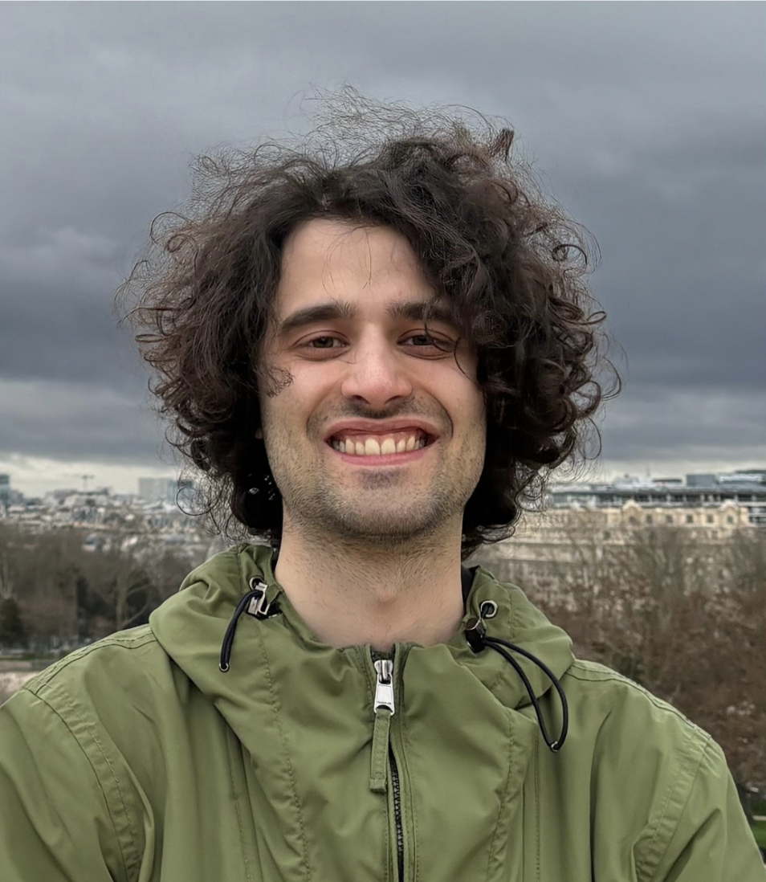
Conclusion
(strong) duality result for Wasserstein DRO of quadratic objectives over distributions supported on a polyhedron
application to DR control with stability and out-of-samples performance and safety guarantees
Open challenges and perspectives:
worst case
expressivity and conservatism
Presentation on Thu @ 14:30
nominal
adding a KL regularization to the transport plan
regularization “smooths” the dual objective…first-order methods?
scalability of SDP
Wang, J., Gao, R., & Xie, Y. (2025). Sinkhorn distributionally robust optimization. Operations Research. Cescon, R., Martin, A., & Ferrari-Trecate, G. (2025). Data-driven Distributionally Robust Control Based on Sinkhorn Ambiguity Sets. arXiv preprint arXiv:2503.20703.

Slide 16
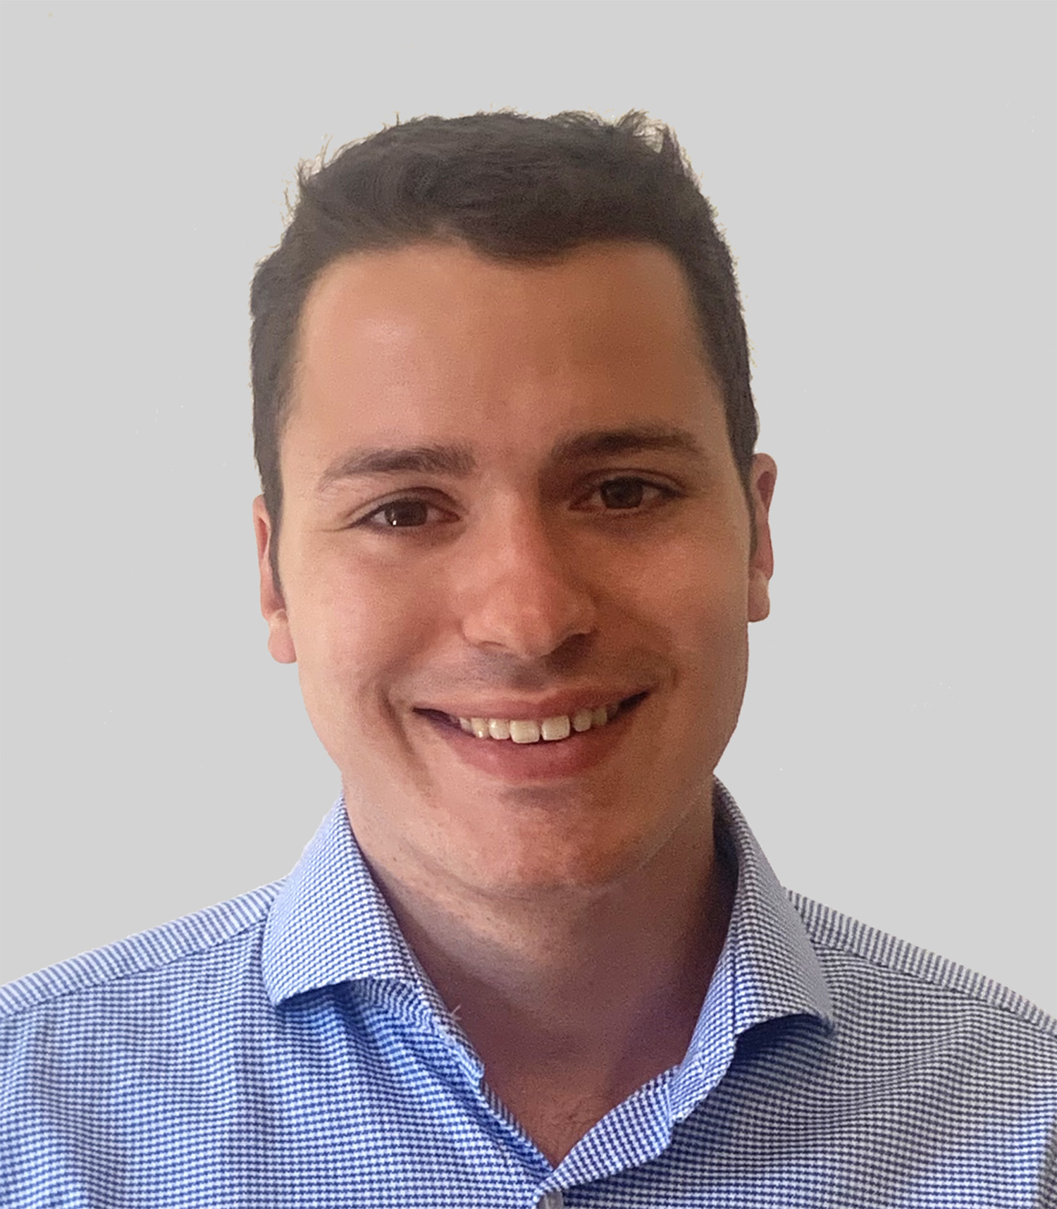
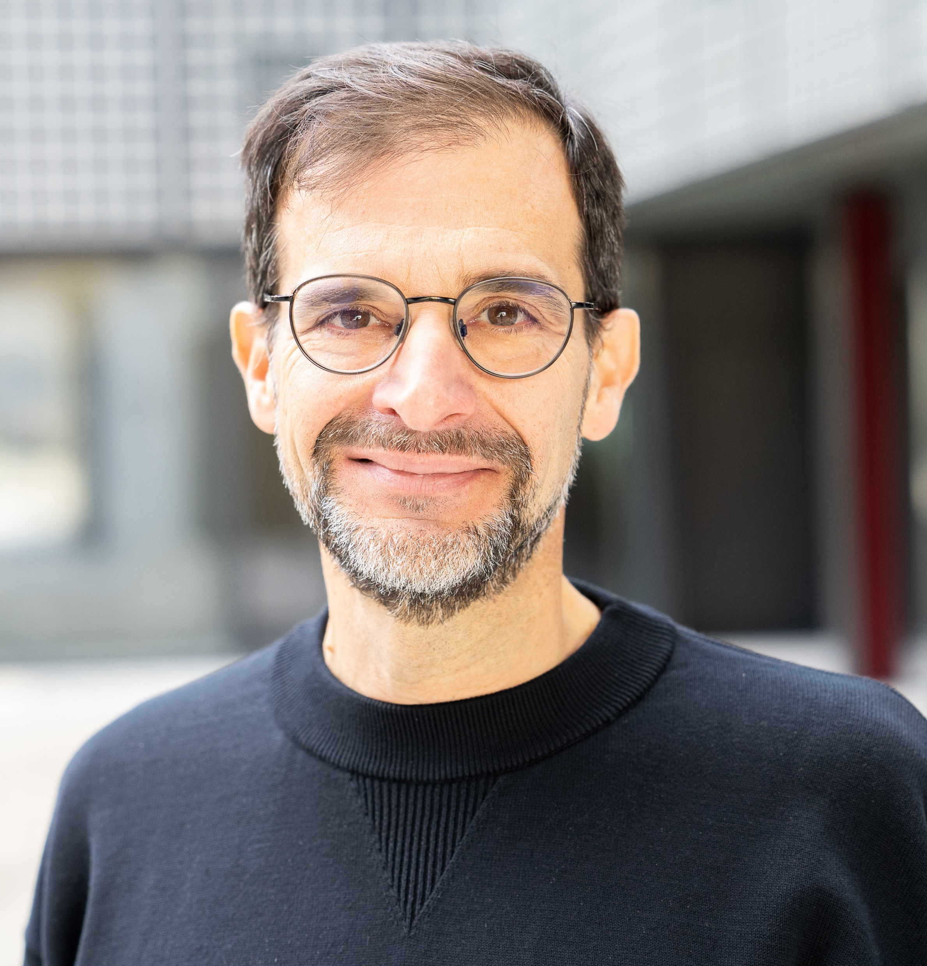
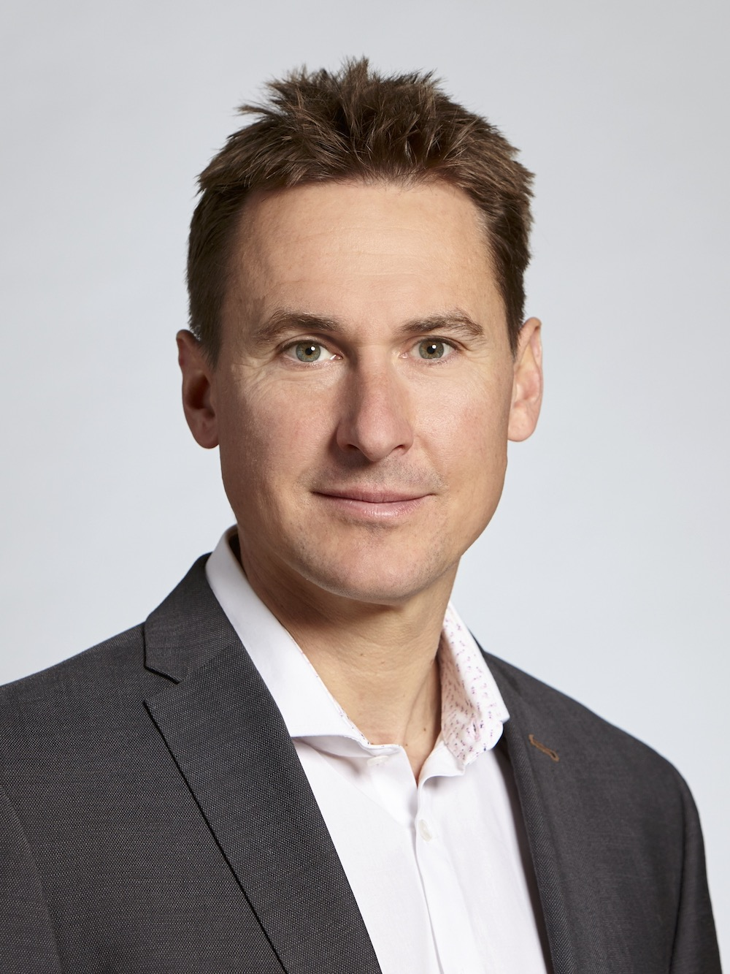
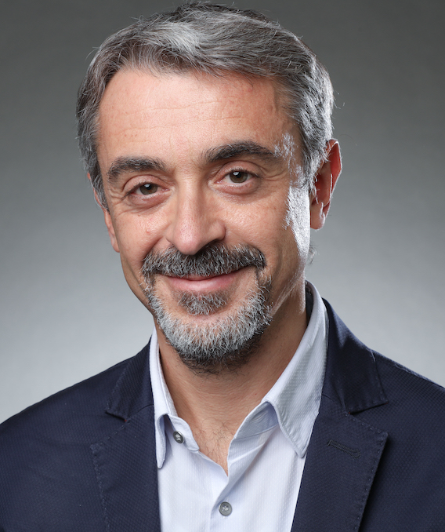

Acknowledgments
Thanks for your attention!
andrmar@kth.se

